Slide 1
The Ashy Bookshelf (aka) United States_LibSyncOS_ME_2000_X_TM
Team 9
Justin Coen Austen Henry
Zach Marcolesco Tricia Schmitz Reagan Wood

Slide 2
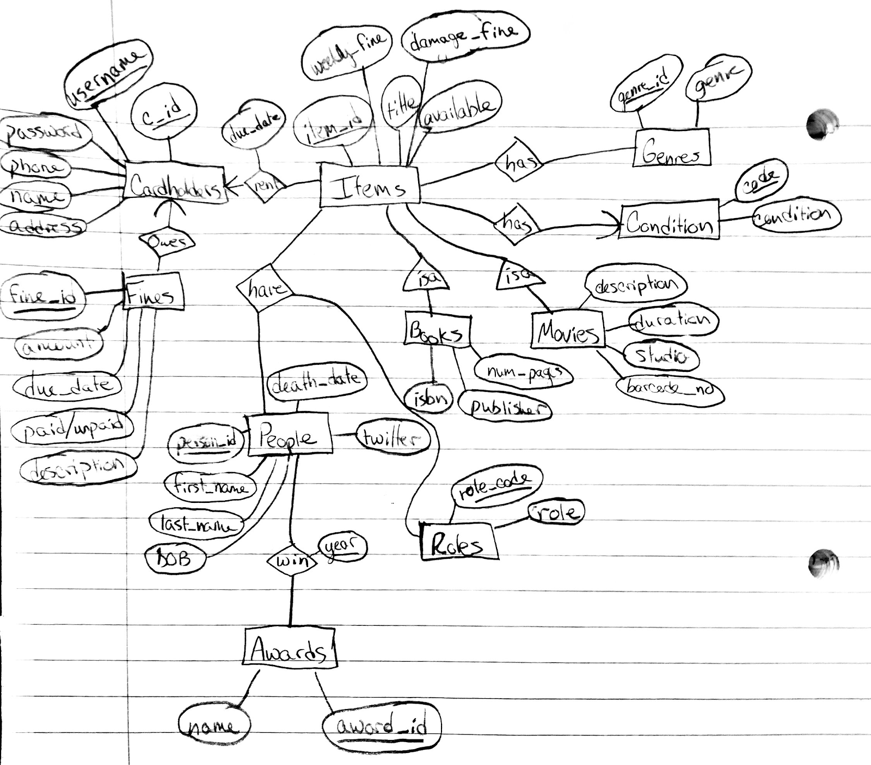

Slide 3
Genres
Cardholders
Cardholder_Item
Items
Condit
Fines
Roles
People
Movies
Books
Awards
username
isa

